Slide 1
Stirring Subsystem
Leader: Iason Chaimalas

Slide 2
Construction
Leader: Iason Chaimalas

Slide 3
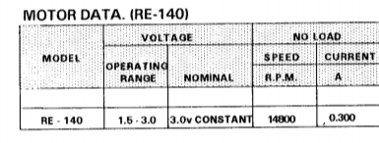
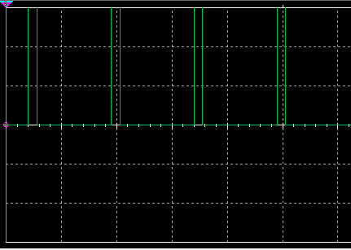
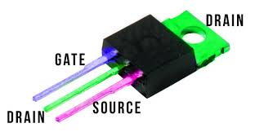
The DC Motor Actuator
Even with no load, the motor can draw over 300mA → High-Current Load
Turning the Gate ON makes the Drain conduct to the Source – switch behaviour.
Options:
digitalWrite → HIGH or LOW write
Manual write
Cannot control RPM
PWM
Duty Cycle easily varied
Transistor ON for PWM HIGH (Vcc), OFF for LOW (GND)
Stirring DC Motor Datasheet
PWM in Bioreactor Oscilloscope
MOSFET – (1) Oscar Liang

Slide 4
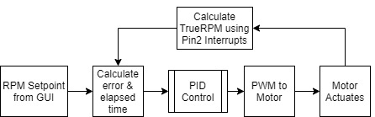
Stirring Code
Implementing Closed-Loop PID Control
Error = Setpoint – TrueRPM
ElapsedTime = time since last loop – used in D and I paths
Very small tuning constants due to large P, I and D error terms
Interrupts attached to Pin2, ISR used to collect number of changes of Pin2 over ElapsedTime

Slide 5
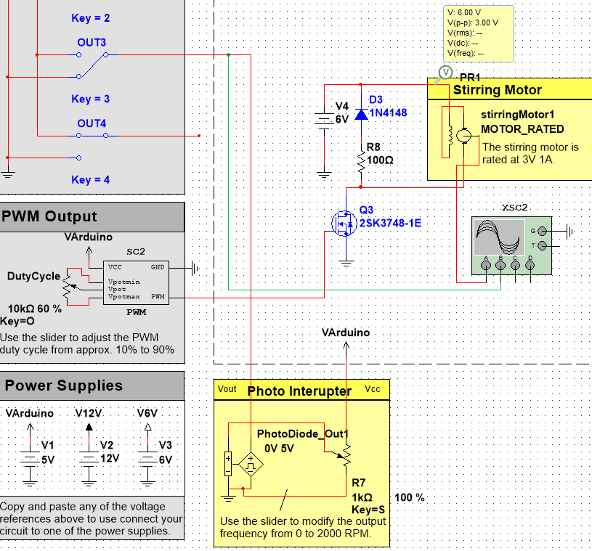
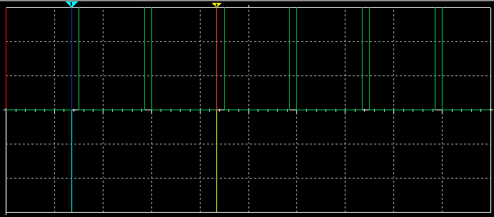
Final Stirring Subsystem in Multisim
Oscilloscope Reading over Photointerrupter - Green

Slide 6
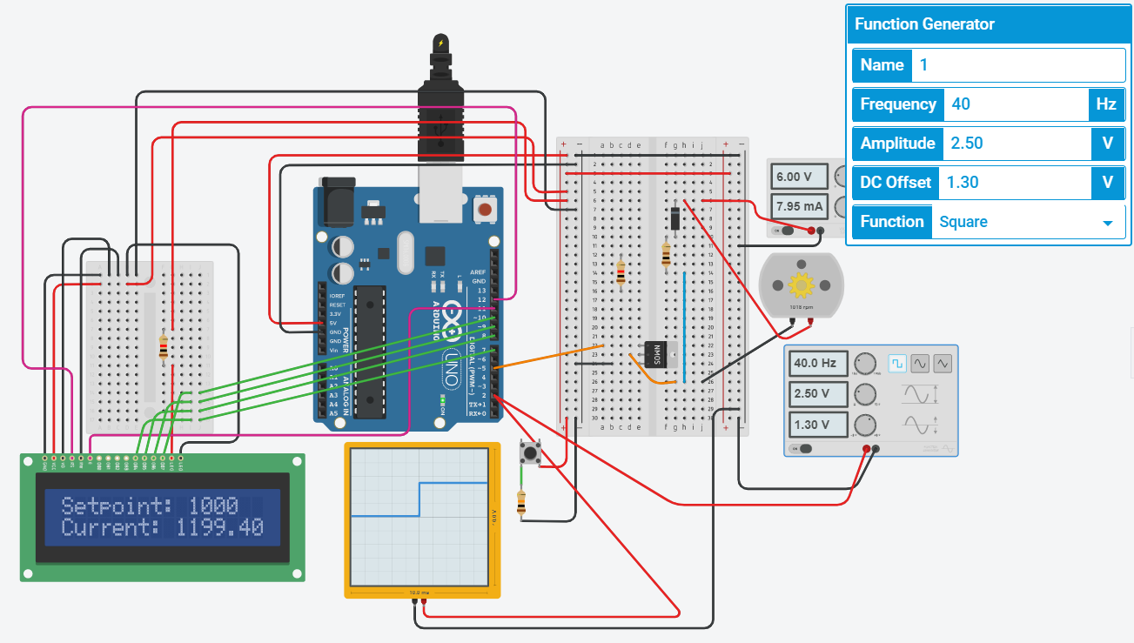
Final Stirring Subsystem in Tinkercad

Slide 7
Discussion
Leader: Iason Chaimalas

Slide 8
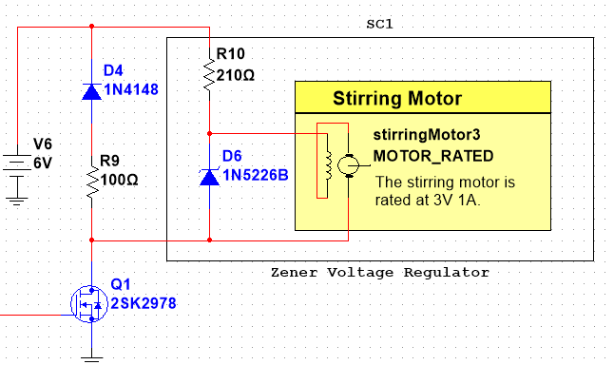
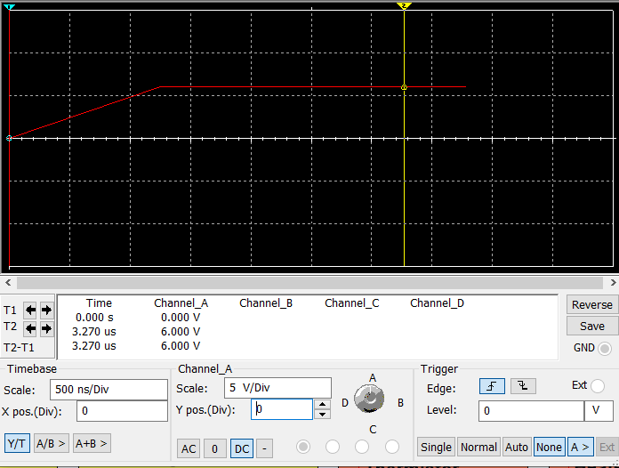
Zener Voltage Regulator
PWM

Slide 9
Results
Leader: Iason Chaimalas

Slide 10
Testing Edge Cases

Slide 11
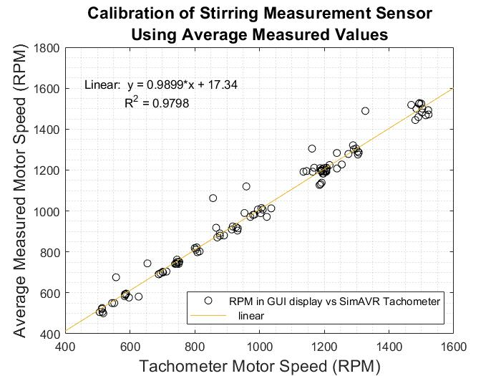
Calibration Curve

Slide 12
Testing Edge Cases

Slide 13
Testing Edge Cases

